Slide 1
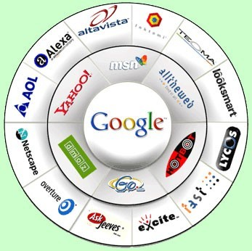
Internet Searching

Slide 2
What is the Internet about?
Have access to information from all around the globe
You can find local and international news, weather reports, sports scores, stock prices, do your baking, shop on-line.
At your fingertips, you can send messages to others, meet new friends, take a course and watch a movie - all from your computer

Slide 3
What is the Internet about?
You can access the Internet from a computer anywhere.
Success in business today requires an understanding of the Internet and how it works.

Slide 4
Reality of searching on the Internet
No two similar searches on the Internet will show the same hit results.
The information on the Internet changes by minute and Web sites that is available today may not be there tomorrow.
You can not believe everything that is posted on the Internet.

Slide 5
Terminology
Internet is a worldwide collection of links that connects businesses, universities, education institutions and individuals

Slide 6
Terminology
World Wide Web / WWW / Net / Web is a portal of the Internet. It consists of a collection of documents stored on computers around the world.
Web page is a document on the Internet that can include text, pictures, sound, video, graphics etc.

Slide 7
Terminology
Web Site is a collection of Web pages.
Search engine is a software program you can use to find Web sites, Web pages and Internet files.

Slide 8
Terminology
Web browser: is a program that allows you to view and explore information on the Internet e.g. Internet Explorer.

Slide 9
Terminology
Browse to search the Internet for information.
Surf - slang for browsing – to search for information on the Internet.

Slide 10
Terminology
URL each Web page has a unique address called a Uniform Resource Locator. You can instantly display any Web page if you know its URL
http://www.google.co.za
http://www.google.com

Slide 11
Terminology
Beware of Stealth URLs
Adult Web sites adopt URLs similar to popular Web sites.
Entice children to access these Web sites.
E.g. Nintendo, Barbie, White House

Slide 12
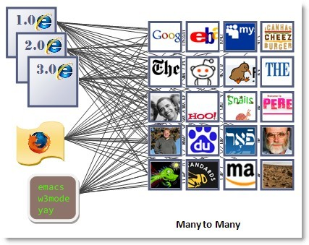
Types of Web pages
Six basic types of Web pages
exist:

Slide 13
Advocacy Web Pages
Contains content that describes a cause, opinion or idea and view of an organization.
The purpose is to convince the reader of the validity of the cause, opinion or idea.
Greenpeace, SPCA

Slide 14
Business / Marketing Web Pages
Contains content that promotes or sells products or services of an organization.
May allow you to purchase their products or services online.
Pick n Pay, Woolworths, Look n Listen

Slide 15
Informational Web pages
Contains factual information.
Many government agencies have informational pages providing information such as census data, tax details and general information.
Other organizations provide information such as public transportation schedules, published research findings.
Kalula.com, Mango, SARS, CSIR

Slide 16
News Web pages
Contains newsworthy material including stories and articles relating to current events, money, sports an the weather.
Provide summaries of printed articles.
CNN, Sky News, Beeld, News24

Slide 17
Portal Web pages
Often called a portal, offers a variety of Internet services from a single convenient location.
Most portals offers the following – search engines, local, national and international news, sport and weather.
Google, AltaVista, Dogpile, Yahoo

Slide 18
Personal Web Pages
A private individual who is normally not associated with any organization, often maintain a personal Web page.
Published for a variety of reasons – hobby, for friend, special interest.

Slide 19
Search engines
A search engine is a tool designed to search for information on the Internet.
The search result are usually presented in a list and are commonly called hits.
The information may consist of Web pages, images, information and other types of files.

Slide 20
Search engines
Search engines work by storing information about Web pages, which they retrieve from the Internet itself.
These pages are retrieved by a Web crawler (also spider) an automated Web browser which follows every link it sees.

Slide 21
Search engines
The usefulness of a search engine depends on the relevance of the result it gives back.
Most search engines employ methods to rank the results to provide the “best” results first.
The research results from different search engines varies widely from one to another.

Slide 22
Search engines
Some search engines also mine data available in newsbooks, databases or open directories.
Search engines operates algorithmically or are a mixture of algorithmic and human input.

Slide 23
Search engines
It is important to remember that when you use a search engine, you are NOT searching the entire Web as it exist at that moment.
Some information is only available on the Invisible Web (Deep Web), and can only be access by using subject directories.

Slide 24
Before you start to search
Think about your search before you begin.
Create a search strategy in your head.
Decide if you only want to brows for information or locate a specific piece of information.
Retrieve everything you can.

Slide 25
Search Strategy
Step 1
Analyze your topic to decide where to begin?
What unique words, distinctive names, abbreviations or acronyms are associated with your topic?
Can you think of societies, organization, or groups that might have information on your topic?

Slide 26
Search Strategy
What unique phrases can you identify in your topic?
Can you think of synonyms or equivalent terms? After all a dog is also a canine, a pooch, a mutt, a hound, a pet and man’s best friend
Can you think of variant spelling of words?

Slide 27
Search Strategy
STEP 2
Decide which type of search engine to use
Keywords
Directories
Google
Yahoo, Aardvark,
Meta search engines
- DogPile,

Slide 28
Search Strategy
Step 3
Change and vary your approach.
Try something different (search engine)
Look while you search you may pick up tips.

Slide 29
Guidelines to successful searching
Be specific - “Hurricane Hugo”
Use nouns and objects as keywords – fiesta dinnerware plates cups saucers
Put the most important term first –
• +hybrid +electric +gas +vehicles

Slide 30
Guidelines to successful searching
Use the asterisk (*) to find plurals of words – retriev* returns retrieves, retrieval, retriever and any other variation.
Type keyword in lowercases to find both lower and uppercase variations – president retrieves president and President.

Slide 31
Guidelines to successful searching
Use more than two keywords – interaction vitamins drugs
Use quotation marks (“”) to create phrases so that the search engine can find the exact sequence of word – “bye bye miss american pie”

Slide 32
Guidelines to successful searching
Use a hyphen alternative – email vs e- mail
Limit search by language.
Use uppercase characters for Boolean operators in your search to differentiate between the words and the operators – cats AND dogs NOT mice

Slide 33
Guidelines to successful searching
Combine keyword wherever possible into phrases – “ search engine tutorials”
Avoid common words e.g. water, unless they form part of a phrase – “bottle water”
Think about words you expect to find in the document and use it as keywords – anorexia bulimia eating disorder

Slide 34
Guidelines to successful searching
Write down your search strategy and revise it before you type it into a search engine query box.
It help to revise your search strategy if your hits were unsuccessful

Slide 35
Guidelines to successful searching
Try an alternative search engine, do not stick to just one.
Use the plus sign (+) to combine words -
Look for alternative ways of spelling a word – col*or returns color (America) and colour (British)

Slide 36
Guidelines to successful searching
Look at alternative ways of phrasing a search – district six, district 6, districtsix
Use the advance search field of a search engine.
Combine keyword with phrases using the double quotes and the plus sign and/or the minus sign -
+cowboys +“wild west” -football -dallas

Slide 37
Guidelines to successful searching
Before you use a search engine read about its help function / or about function.
Read the FAQ of a search engine, it provide helpful hints on how to search.

Slide 38
Advance search strategy
Enter what you are looking for in the search field, followed by the word site and a colon (:), and then the domain name.
admission site: www.utoronto.ac

Slide 39
Before you click to view the page
Evaluating Web pages skilfully requires you to do two things at once:
Train your eye and your fingers to employ a series of techniques that help you quickly find what you need to know about the Web.
Train your mind to think critically, even suspiciously by asking a series of questions that will help you decide how much a Web page is to be trusted.

Slide 40
Before you click to view the page
Look at the URL
Is it somebody’s personal Web site or page
~ or % or users or members
Look for a personal name - personal Web site are not necessarily “bad”, but you need to investigate them carefully

Slide 41
Before you click to view the page
Domain name
Is the domain extension appropriate for the content?
Government sites look for gov, mil
Education or academic sites look for edu, ac
Non-profit organizations look for com, org, net

Slide 42
Before you click to view the page
Domain name
Country code look for au, sa, za, uk, us, fr
Country codes no longer tightly controlled but can still indicate where the page originate from

Slide 43
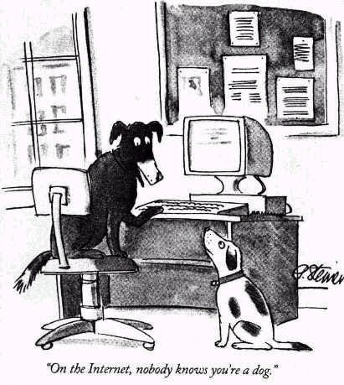
Why is it important to evaluate what you find in the Web?
Anyone can put information on the Web

Slide 44
Why is it important to evaluate what you find in the Web?
Many pages are not updated and the information becomes absolute.
No control exist about the quality and trustworthiness off the information available on the Internet.

Slide 45
Why is it important to evaluate what you find in the Web?
Web pages are created with a specific purpose in mind – They do not simply grow in the Web like mildew

Slide 46
How to evaluate a Web Page
Can you tell who wrote it?
Name of page author?
Name of the organization, institution, agency do you recognize it?
E-mail and contact details
Authors credentials on the subject

Slide 47
How to evaluate a Web Page
Credentials for the subject matter?
Looks for links to: “About us” “Philosophy” “Background” “Biography”
Is it current?
Look for “last updated” date

Slide 48
How to evaluate a Web Page
Are there any links to other Web page?
Does the links open?
Look for a link called “additional sites” “related sites” “related links”
Look who link to that We page
Are there many links?
What kind of sites does link to it?

Slide 49
Evaluating Web Pages
Was the page put on the web to
Inform – give facts or data
Persuade / explain
Sell / entice
Is it appropriate for your purpose?
Think about the “tone” of the page
Is it as credible and useful as the resources available in print or through the library.

Slide 50
Do some detective work
Search the URL in alexa.com
Click on “Site info for …”
Who owns the domain?
Who links the site?
What did the site look like in the past?

